Slide 1
Intro to CSS
Web Development Club
Dept. of CSE, RU
http://www.ru.ac.bd/cse

Slide 2
Introduction to CSS
A.F.M. Mahbubur Rahman
Asst. Professor
Dept. of Computer Science & Engineering
Email : m.r.kushal@gmail.com
Contact : 01911064969

Slide 3
CSS Basic

Slide 4
What is CSS?
CSS stands for Cascading Style Sheets
CSS defines how to display HTML elements on webpage
CSS was added to HTML 4.0
It was intended to allow developers to separate content from design
Style sheets allow web pages to be optimized for more than one type of devices such as PDAs and cell phones or for printing

Slide 5
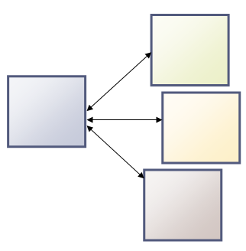
Advantage Of using CSS
Easy to maintain
a single CSS file can be used to control the appearance of multiple HTML documents.
Changing the appearance of an entire site can be done by editing only the CSS file
HTML1
CSS
HTML2
HTML3

Slide 6
Advantage Of using CSS
Faster page loading
removal of all presentation from HTML documents reduces the file sizes of web page and results in faster page loading
Reduces Bandwidth Consumption
A style sheet will usually be stored in the browser cache, and can therefore be used on multiple pages without being reloaded, reducing data transfer over a network.

Slide 7

Advantage Of using CSS …
Website Accessibility
Using CSS web pages can be styled specifically for different media, including browsers, printers, handheld devices without changing the content or document structure in any way. This makes websites more accessible.

Slide 8
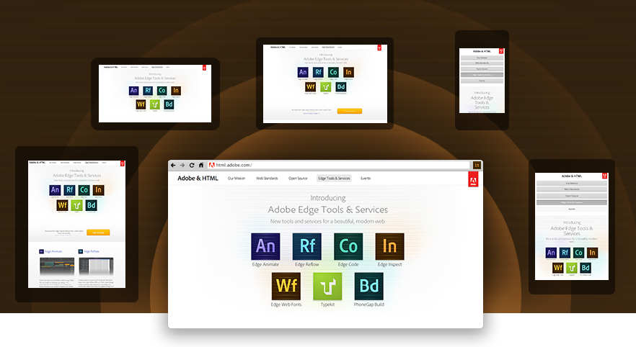
Same website in multiple devices

Slide 9
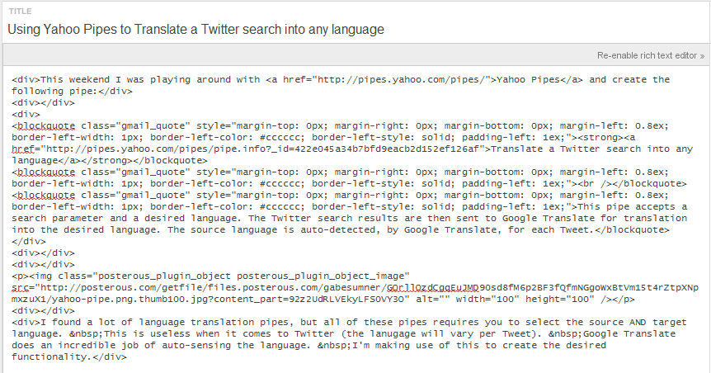
Advantage Of using CSS …
CSS makes website SEO friendly
CSS makes HTML code more clean and it results in better search engine ranking of the web site.
A dirty HTML Page

Slide 10
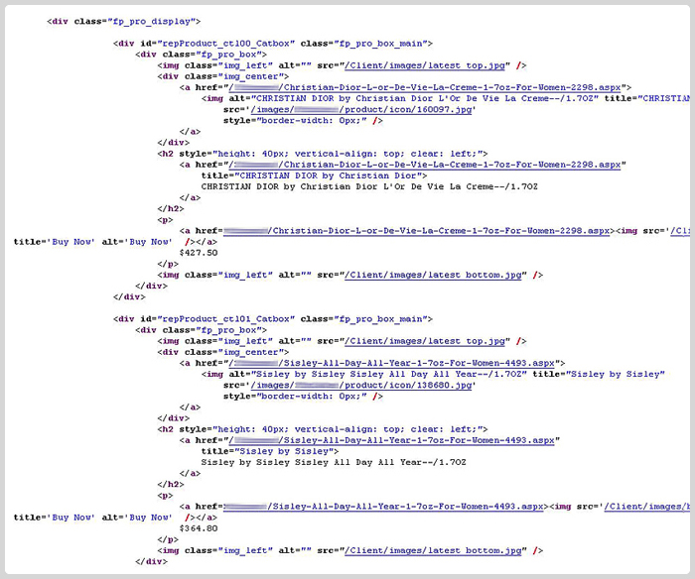
SEO friendly Page

Slide 11
CSS Syntax
A CSS rule has two main parts:
A selector
normally the HTML element you want to style
One or more declarations
consists of a property and a value
property is the style attribute you want to change
CSS declarations always ends with a semicolon, and declaration groups are surrounded by curly brackets

Slide 12
CSS Syntax (Cont.)
An Example
p
{
color:red;
text-align: center;
}
selector
Declaration
Attribute
Value

Slide 13
CSS Selector
Element Selector
Id Selector
Class Selector

Slide 14
The Element Selector
The Element selector is used to specify a style for an HTML elements like <p>, <h1>, <li>, <div> etc.
p {
font-family: Arial;
font-size: 14pt;
}
h1 {
color: black;
border: 5px solid black;
}

Slide 15
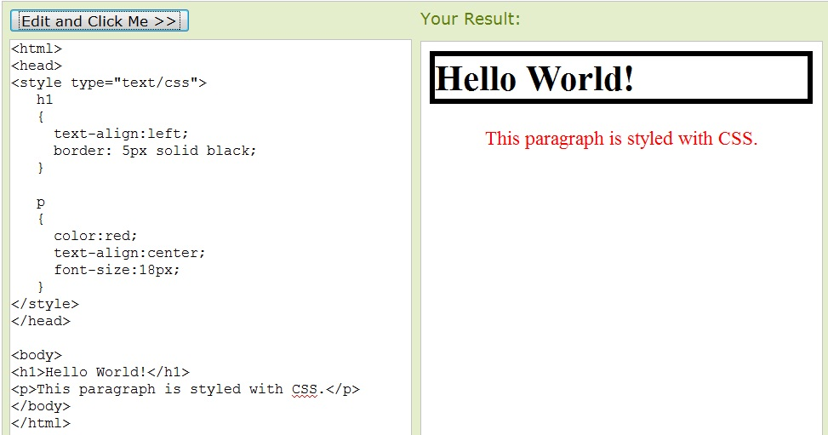
The Element Selector
The Element selector is used to specify a style for HTML elements like <body>,<p>, <h1>, <li>, <div>, <img> etc.

Slide 16
The Id Selector
The id selector is used to specify a style for a single, unique element.
The id selector uses the id attribute of the HTML element
and is defined with a "#“ followed by a unique Id name (e.g. #left_menu)

Slide 17
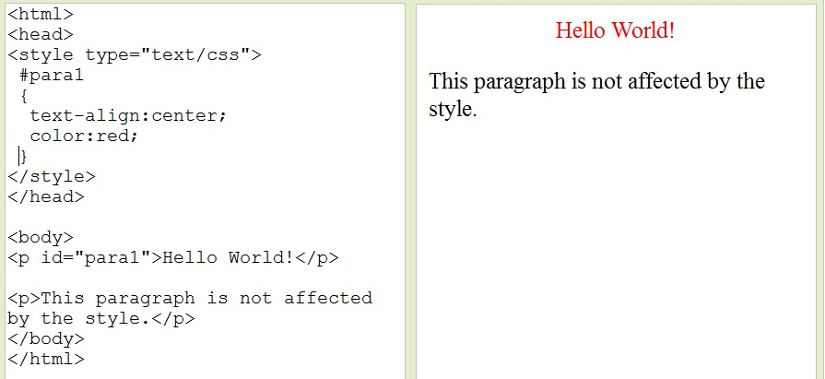
The Id Selector (Example)
The style rule below will be applied to the element with id="para1":

Slide 18
The class Selector
used to specify a style for a group of elements.
This allows you to set a particular style for any HTML elements with the same class
The class selector uses the HTML class attribute, and is defined with a ".“ followed by a class name (i.e : .text)

Slide 19
Example
In the example below, all HTML elements with class="center" will be center-aligned
.center
{
text-align:center;
}
<p class=“center”>sample text</p>
<h1 class =“center”> Sample header </h1>

Slide 20
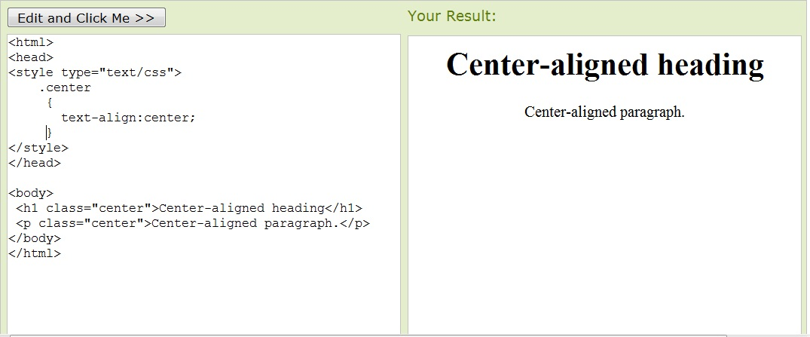
Example
In the example below, all HTML elements with class="center" will be center-aligned

Slide 21
Selector Grouping
In style sheets there are often elements with the same style. To minimize the code, we can group selectors.
h1 , h2, p
{ color:green; }
h1 { color:green; } h2 { color:green; } p { color:green; }

Slide 22
CSS Comments
A CSS comment begins with "/*", and ends with "*/", like this:
/*This is a comment*/
p { text-align:center; /*This is another comment*/ color:black; font-family:arial; }

Slide 23
Including CSS in web page
External style sheet
Embedded style sheet
Inline style

Slide 24
External style sheet
An external style sheet is ideal when the style is applied to many pages
Usually A file with .css extension contains style
The <link> tag is used inside the head section to include external style sheet in a web page
<head> <link rel="stylesheet" type="text/css" href="mystyle.css" />
</head>

Slide 25
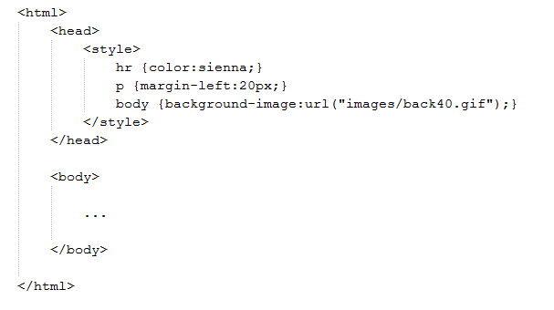
Embedded Style Sheet
An embedded style sheet should be used when a single document has a unique style.
internal styles are defined in the head section of an HTML page, by using the <style> tag, like this:

Slide 26
Inline Styles
To use inline styles you use the style attribute in the relevant tag. The style attribute can contain any CSS property. The example shows how to change the color and the left margin of a paragraph:
<p style="color:#ff00ff; margin-left:20px"> This is a paragraph. </p>

Slide 27
A Problem
p { color:red; font-size:40px; }
In External style sheet
p { color:green; font-size:30px; }
In embedded style sheet
p { color:blue; }
inline style
<html>
<head>
<style type="text/css">
p { color:red; }
</style>
</head>
<body>
<p style=“color:blue”>What will be my color?</p>
</body>
</html>

Slide 28
Cascading Rule
All the styles will "cascade" into a new "virtual" style sheet by the following rules
Browser default (lowest Priority)
External style sheet
Embedded style sheet
Inline style (Highest Priority)
So, an inline style (inside an HTML element) has the highest priority, which means that it will override a style defined inside the <head> tag, or in an external style sheet, or in a browser (a default value).

Slide 29
So the text color of the
paragraph will be…. ?
Blue and
font size =30px

Slide 30
CSS Background

Slide 31
CSS background properties are used to define the background effects of an element.
Common CSS properties used for background effects:
background-color
background-image
background-repeat

Slide 32
Background Color
The background-color property specifies the background color of an element.
The background color can be specified by:
Name - a color name, like "red"
RGB - an RGB value, like "rgb(255,0,0)"
Hex - a hex value, like "#ff0000"

Slide 33
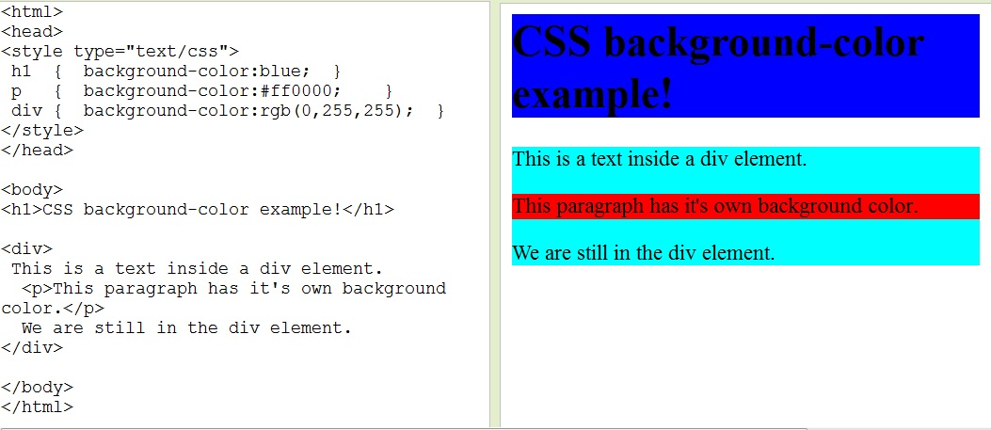
Background Color (Example)

Slide 34
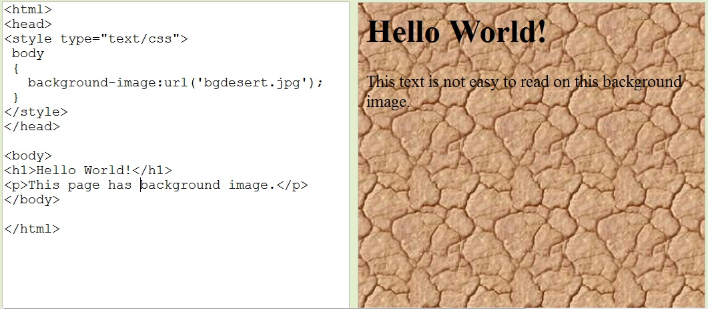
Background Image
The background-image property specifies an image to use as the background of an element.

Slide 35
background-repeat
The background-repeat property sets if/how a background image will be repeated
Value | Description
repeat | The background image will be repeated both vertically and horizontally. This is default
repeat-x | The background image will be repeated only horizontally
repeat-y | The background image will be repeated only vertically
no-repeat | The background-image will not be repeated

Slide 36
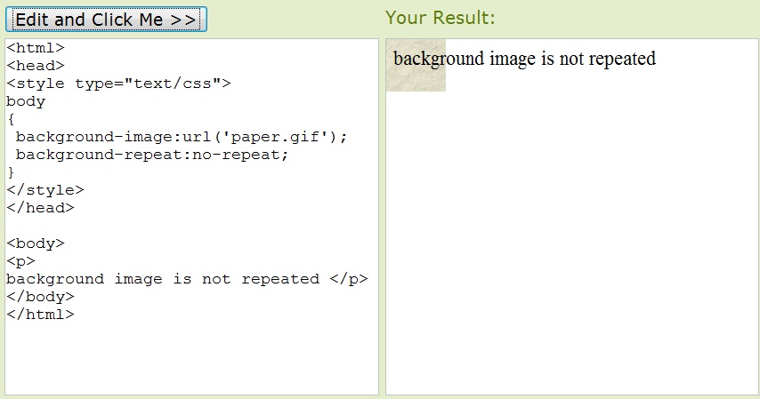
background-repeat Example (no-repeat)

Slide 37
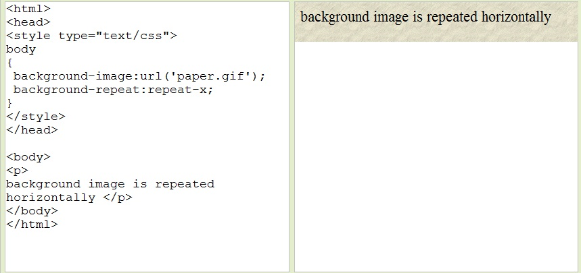
background-repeat Example (repeat-x)

Slide 38
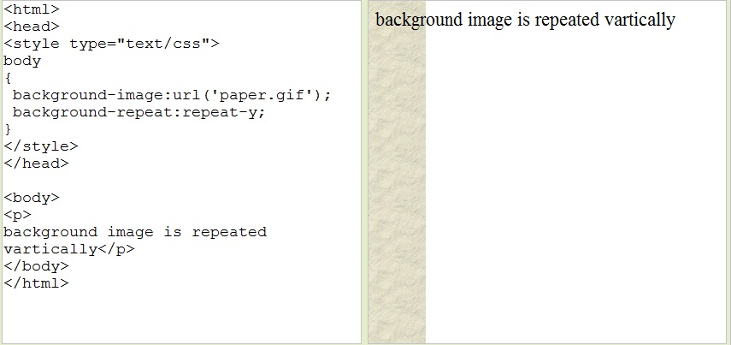
background-repeat Example (repeat-y)

Slide 39
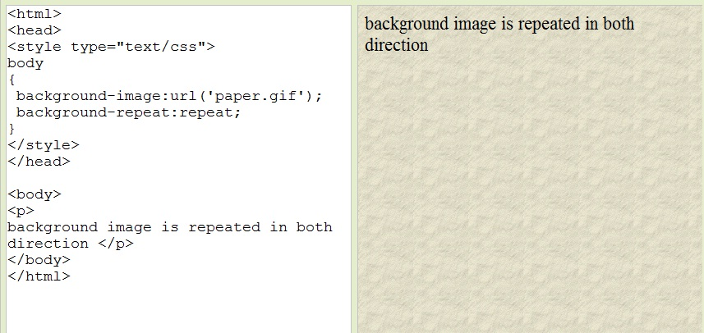
background-repeat Example (repeat)

Slide 40
CSS Text

Slide 41
Common CSS text properties are
Text Color
Text Alignment
Text Transformation
Text Indentation

Slide 42
Text color
The color properties is used to change text color in css
Syntex-
color: color_value;
With CSS, a color is most often specified by:
a HEX value - like "#ff0000"
an RGB value - like "rgb(255,0,0)"
a color name - like "red"

Slide 43
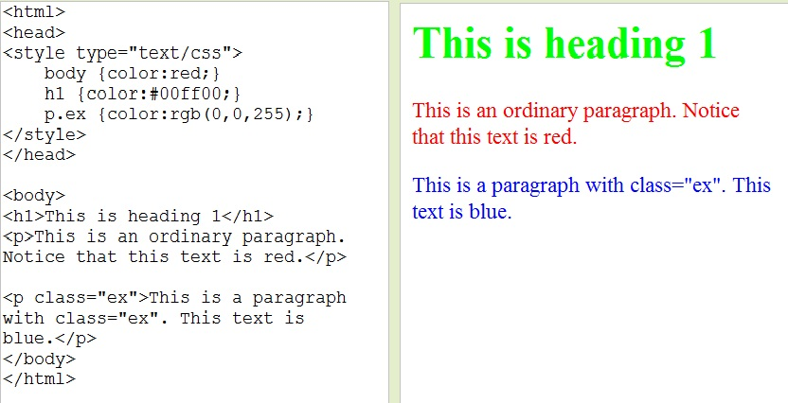
Text Color
The color property is used to set the color of the text.

Slide 44
Text alignment
The text-align property is used to set the horizontal alignment of a text.
Text can be centered, or aligned to the left or right, or justified.
Value | Description
left | Text is left aligned
center | Text is center aligned
right | Text is right aligned
justify | Text is justified

Slide 45
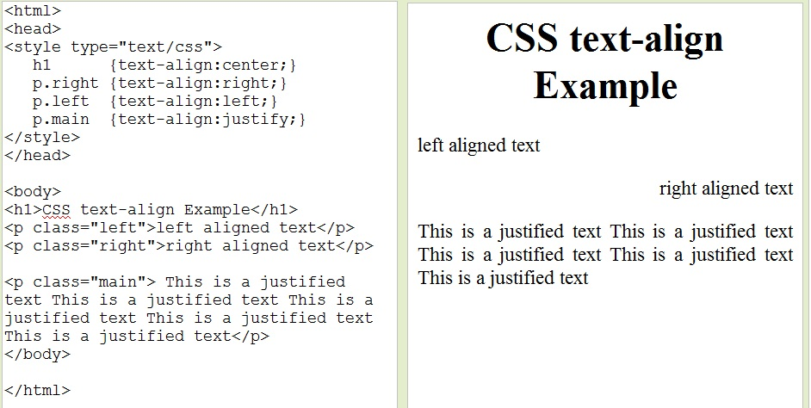
Text Alignment
The text-align property is used to set the horizontal alignment of a text. Text can be centered, or aligned to the left or right, or justified.

Slide 46
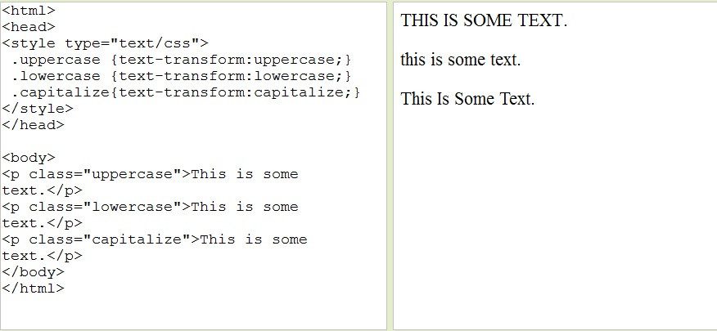
Text Transformation
The text-transform property is used to specify uppercase and lowercase letters in a text.

Slide 47
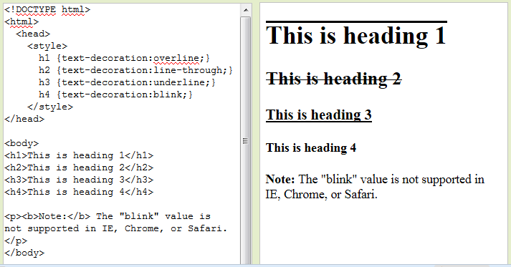
Text Decoration
The text-decoration property is used to set or remove decorations from text.

Slide 48
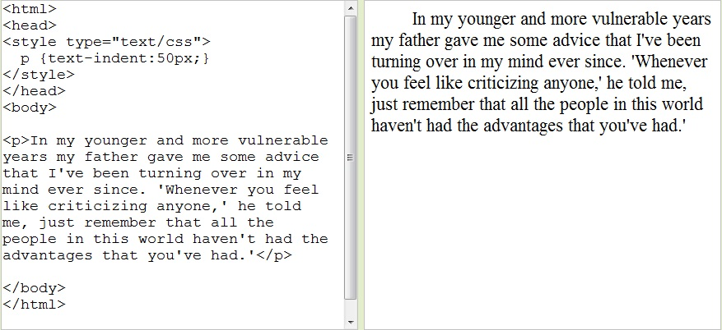
Text Indentation
The text-indentation property is used to specify the indentation of the first line of a text.

Slide 49
CSS Font

Slide 50
Common CSS font properties are
Font Family
Font Size
Font-style
Font-weight

Slide 51
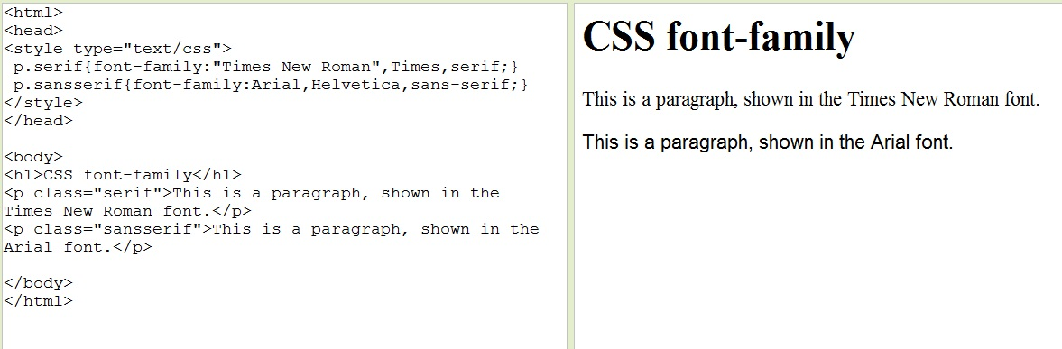
Font Family
The font family of a text is set with the font-family property.
The font-family property should hold several font names as a "fallback" system. If the browser does not support the first font, it tries the next font

Slide 52
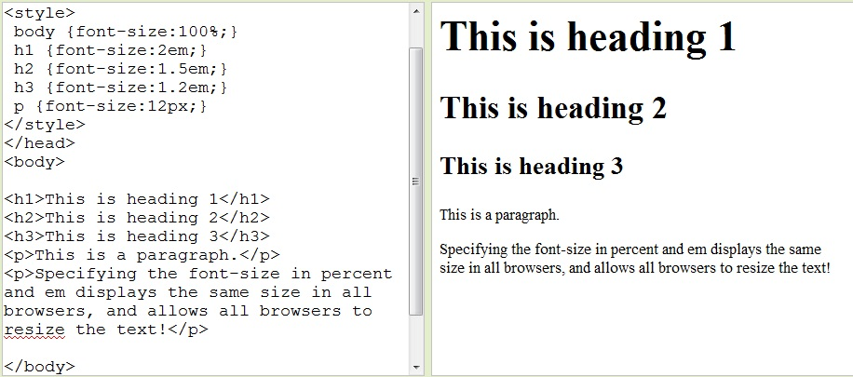
Font Size
The font-size property sets the size of the text. The font-size value can be an absolute (px), or relative size(em or %).

Slide 53
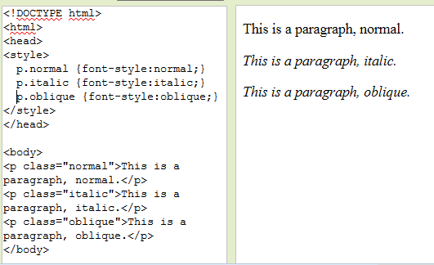
Font Style
The font-style property is mostly used to specify italic text.
This property has three values:
normal - The text is shown normally
italic - The text is shown in italics
oblique - The text is "leaning" (oblique is very similar to italic, but less
supported)

Slide 54
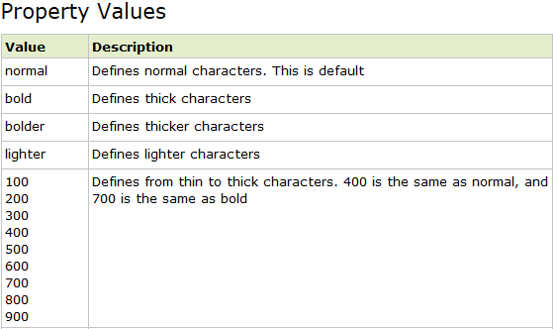
Font Weight
The font-weight property sets how thick or thin characters in text should be displayed.

Slide 55
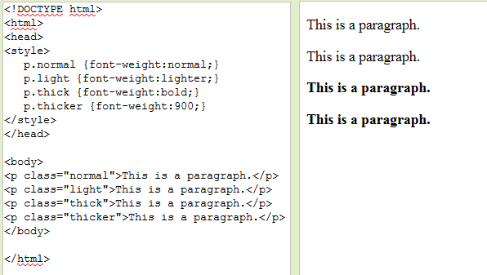
Font Weight
The font-weight property sets how thick or thin characters in text should be displayed.

Slide 56
CSS Box Model

Slide 57
CSS Box Model
All HTML elements can be considered as boxes
The CSS box model consists of:
Margins
Borders
Padding and
the actual content.

Slide 58
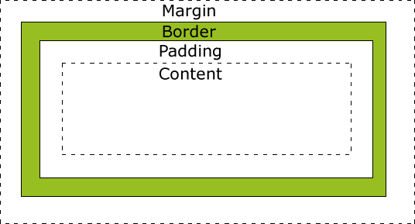
CSS Box Model
Margin - Clears an area around the border. The margin does not have a background color, and it is completely transparent
Border - A border that lies around the padding and content. The border is affected by the background color of the box
Padding - Clears an area around the content. The padding is affected by the background color of the box
Content - The content of the box, where text and images appear

Slide 59
CSS Border

Slide 60
Common CSS Border properties are
Border Style
Border Width
Border Color

Slide 61
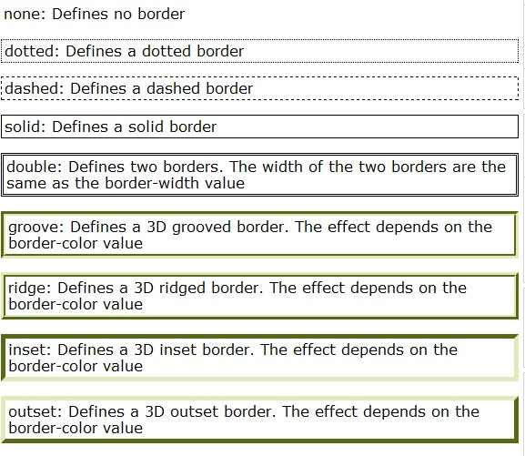
Border Style
The border-style property specifies what kind of border to display

Slide 62
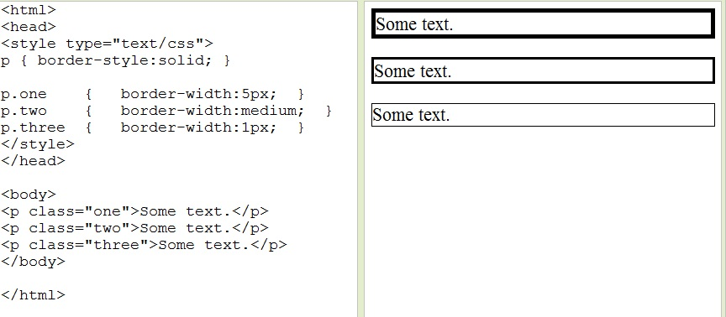
Border Width
The border-width property is used to set the width of the border. The width is set in pixels, or by using one of the three pre-defined values: thin, medium, or thick.

Slide 63
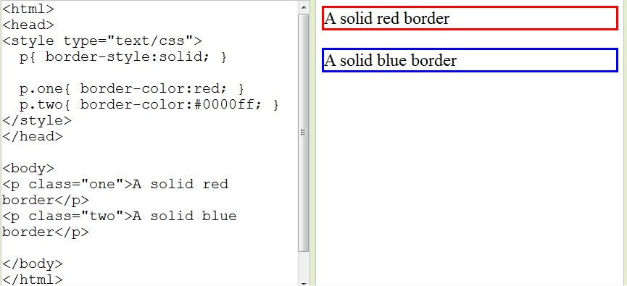
Border Color
The border-color property is used to set the color of the border. The color can be set by name (like “red”), RGB (like "rgb(255,0,0)“ ) or Hex (like "#ff0000“ )

Slide 64
CSS Margin

Slide 65
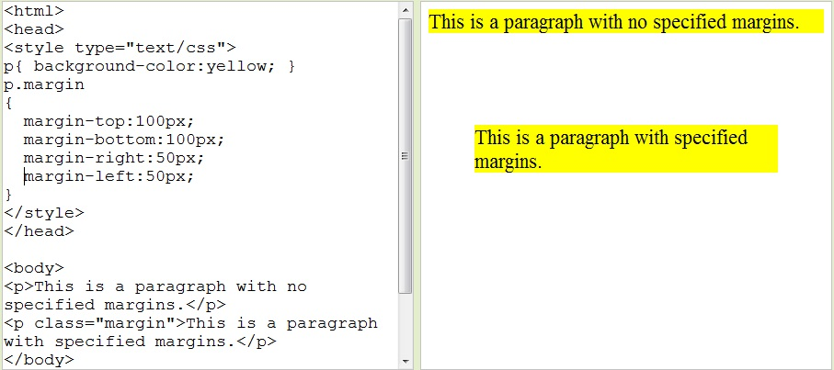
Margin
The margin clears an area around an element (outside the border). The margin does not have a background color, and is completely transparent.
The top, right, bottom, and left margin can be changed independently

Slide 66
CSS Padding

Slide 67
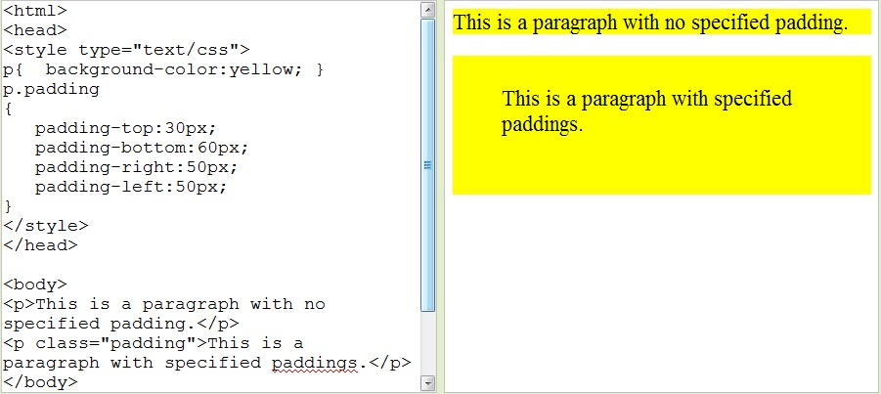
Padding
The padding clears an area around the content (inside the border) of an element.
The top, right, bottom, and left padding can be changed independently using separate properties

Slide 68
CSS List Properties

Slide 69
The CSS list properties allow us to
Set different list item markers for ordered lists
Set different list item markers for unordered lists
Set an image as the list item marker

Slide 70
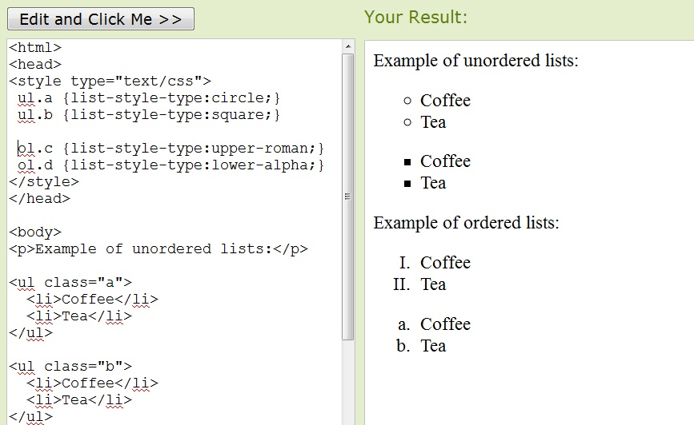
Different List Item Markers
The type of list item marker is specified with the list-style-type property

Slide 71
Different List Item Markers
Possible list-style-type property Values for unordered list
Value | Description
none | No marker
disc | Default. The marker is a filled circle
circle | The marker is a circle
square | The marker is a square

Slide 72
Different List Item Markers
Possible list-style-type property Values for ordered list
Value | Description
armenian | The marker is traditional Armenian numbering
decimal | The marker is a number
decimal-leading-zero | The marker is a number padded by initial zeros (01, 02, 03, etc.)
georgian | The marker is traditional Georgian numbering (an, ban, gan, etc.)
lower-alpha | The marker is lower-alpha (a, b, c, d, e, etc.)
lower-greek | The marker is lower-greek (alpha, beta, gamma, etc.)
lower-latin | The marker is lower-latin (a, b, c, d, e, etc.)
lower-roman | The marker is lower-roman (i, ii, iii, iv, v, etc.)
upper-alpha | The marker is upper-alpha (A, B, C, D, E, etc.)
upper-latin | The marker is upper-latin (A, B, C, D, E, etc.)
upper-roman | The marker is upper-roman (I, II, III, IV, V, etc.)

Slide 73
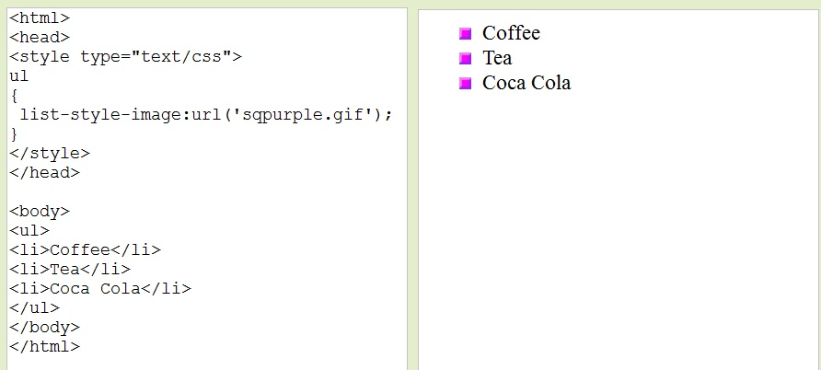
An Image as The List Item Marker
To specify an image as the list item marker, use the list-style-image property

Slide 74
Measurement Units
Unit | Description
% | percentage
in | inch
cm | centimeter
mm | millimeter
em | 1em is equal to the current font size. 2em means 2 times the size of the current font.
ex | one ex is the x-height of a font (x-height is usually about half the font-size)
pt | point (1 pt is the same as 1/72 inch)
pc | pica (1 pc is the same as 12 points)
px | pixels (a dot on the computer screen)

Slide 75
Q & A
?

